Slide 1

SMART INDIA HACKATHON 2026
Face Off
TITLE PAGE
Problem Statement - QR-based UPI payments are ubiquitous in India, but missing merchant verification makes users vulnerable to QR replacement scams and payment redirection fraud.
Problem Statement ID – SIH26199
Theme- Cybersecurity and Fintech
PS Category- Software
Team Name – TEAM FACEOFF
Team Members – Appandairaj .J, Vijay Kumar Paliwal .D, Guna Ranjan .M, Krithick, Devadharshini .B, Divya .S

Slide 2
TITLE –QRShield API
Face Off
QRShield AI — Fraud Intelligence API
QRShield AI integrates with existing UPI apps to run real-time fraud analysis before payment confirmation. It provides merchant verification, QR identity checks, a fraud intelligence database, AI risk scoring, reputation analysis, and a Voice Payment Assistant to alert users audibly when something looks suspicious.
Merchant Verifcation Engine
Fraud Intelligence Database
AI Risk Scoring
Voice Payment Assistant
Generates a risk score (0–100) using historical behavior, anomaly detection, and QR validation.
Confirms merchant identity, registered UPI ID, and official QR registration.
Maintains verified merchants, fraud reports, reputation, and history for decisions.
Announces payment details aloud: e.g., “You are about to pay ₹250 to ABC Grocery Store.” Warns when mismatch or risk is detected.

Slide 3
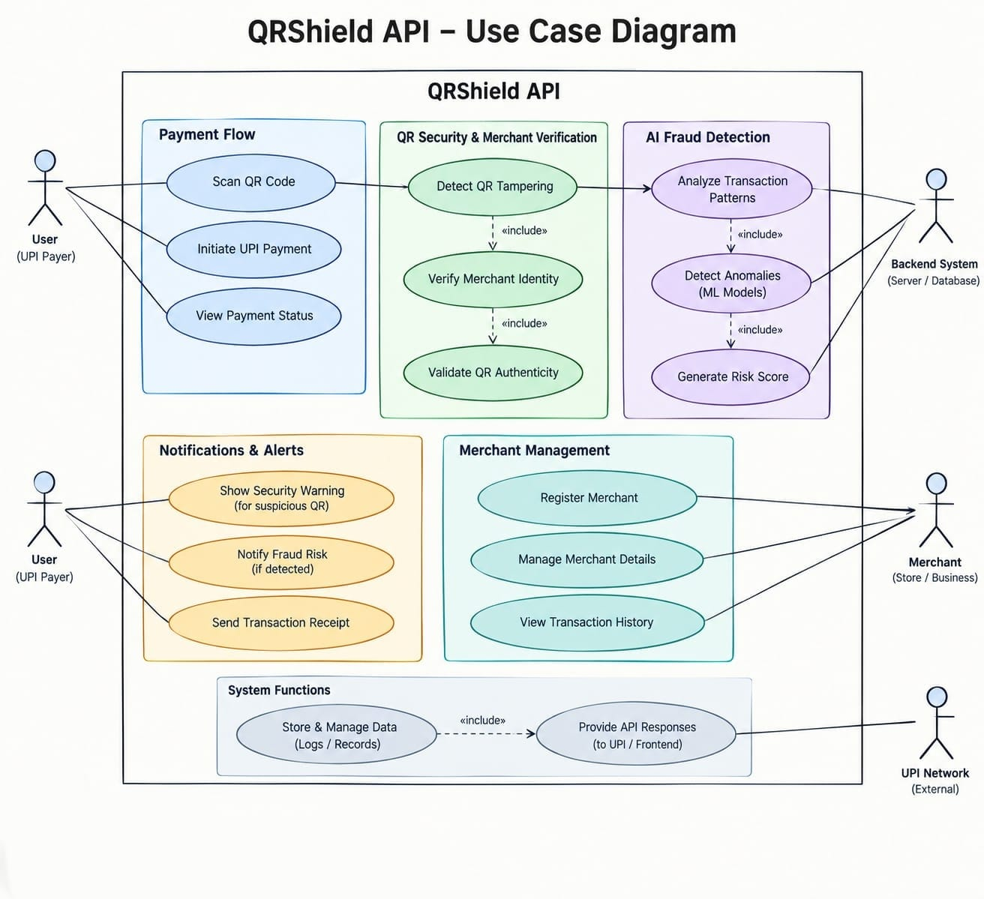



TECHNICAL APPROACH
Face Off
Mobile Integration SDK
Flutter: Cross-platform client DSK enabling seamless UPI scanner intercepts and native UI alerts.
Backend & API Engine
Node.js & Express: Scalable RESTful endpoints secured with JWT for high-concurrency request routing.
AI & Risk Scoring Engine
Algorithm and Model: Isolation Forest models and rule-based evaluation delivering real-time risk scores (0–100).

Slide 4
FEASIBILITY AND VIABILITY
Mobile Integration SDK
Flutter: Cross-platform client DSK enabling seamless UPI scanner intercepts and native UI alerts.
Backend & API Engine
Node.js & Express: Scalable RESTful endpoints secured with JWT for high-concurrency request routing.
AI & Risk Scoring Engine
Python & scikit-learn: Isolation Forest models and rule-based evaluation delivering real-time risk scores (0–100).
Face Off
Feasibility
Implementation Viability
Existing Technology: Uses proven technologies such as AI/ML, REST APIs, QR decoding and cloud infrastructure.
Strong user value: Provides visual and voice warnings before a potentially fraudulent payment proceeds.
Ecosystem compatibility: Designed around UPI QR/payment workflows rather than creating an entirely separate payment system.
Real-Time Detection: Behavioural and transaction-pattern analysis can generate risk scores with minimal payment delay.
Scalable use: The same API model could potentially serve multiple UPI apps, fintech platforms and banking partners.
Scalable Integration: Modular API architecture can integrate with authorized UPI ecosystem partners and scale through cloud deployment.
Future expansion: Your PPT proposes pilot deployment with fintech/payment aggregators and banks, along with expanded biometric verification and banking risk alerts.
Cost & Resources: Can be developed incrementally using open-source tools, cloud services and synthetic data during the prototype stage.

Slide 5


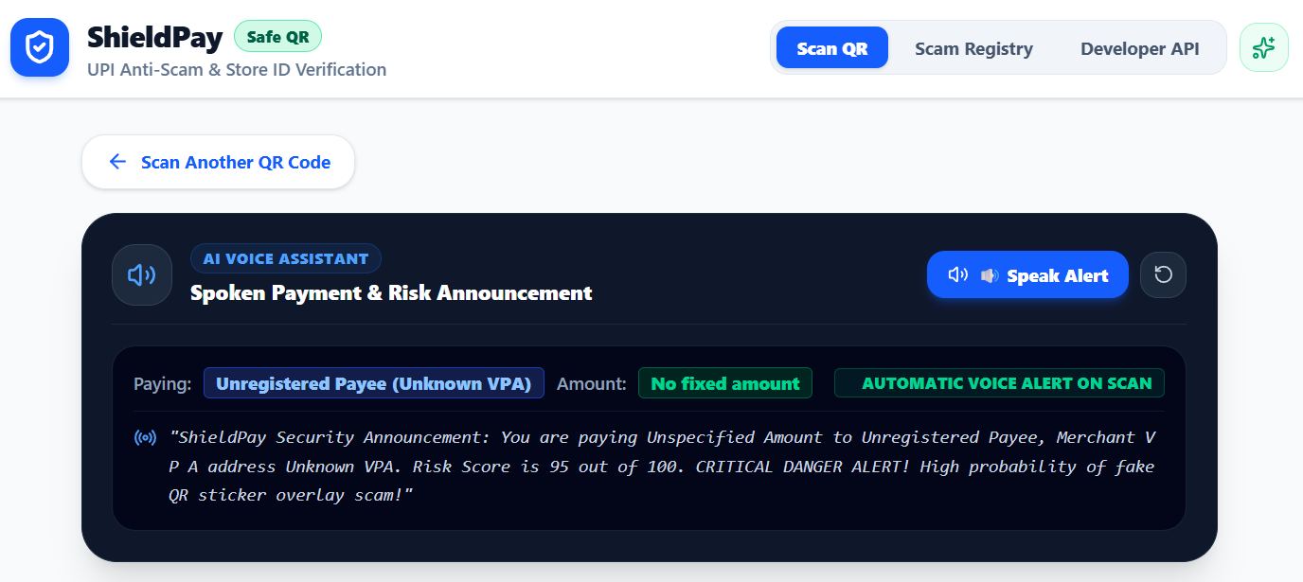


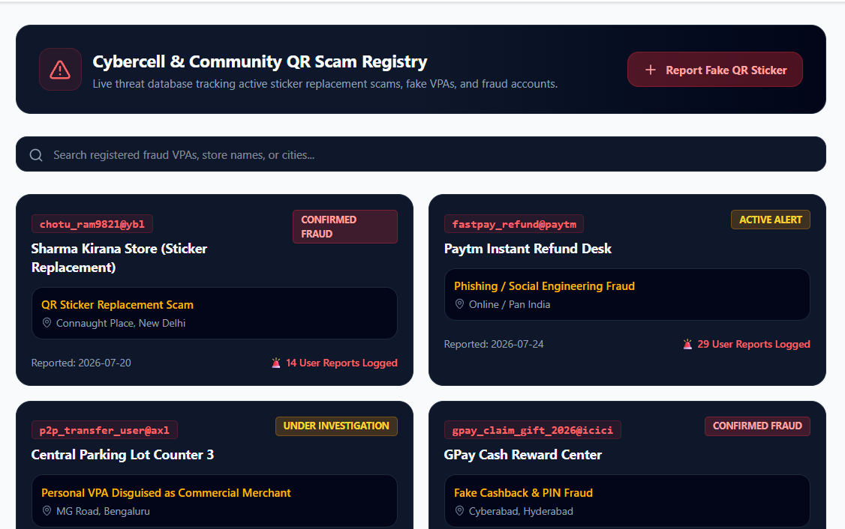

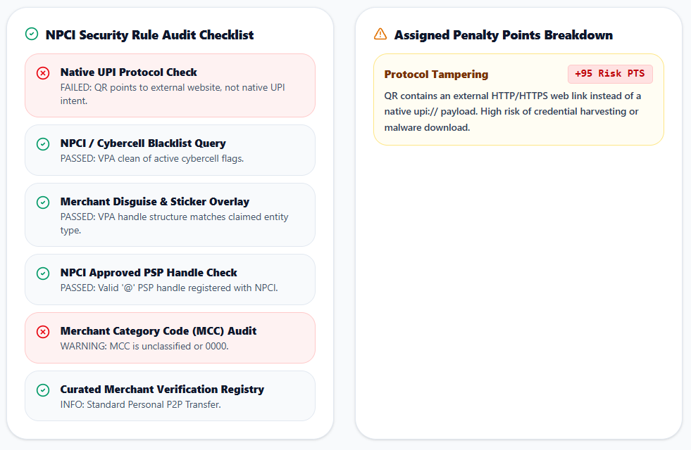
IMPACT AND BENEFITS
Face Off
Enhanced Safety
Ecosystem Trust
Protects millions of everyday digital payment users against subtle QR-swapping redirection attacks.
Improves overall confidence in India's booming UPI infrastructure without disrupting native UX workflows.
Real-Time Defense
Stops fraudulent transactions before money leaves the user account through instant voice/visual warnings.

Slide 6

RESEARCH AND REFERENCES
Face OFF
NPCI (National Payments Corporation of India): https://www.npci.org.in/
UPI Product Overview:
https://www.npci.org.in/what-we-do/upi/productoverview
Krombholz et al., “QR Code Security – How Secure and Usable Apps Can Protect Users Against Malicious QR Codes,” IEEE ARES, 2015.
https://link.springer.com/chapter/10.1007/978-3-319-07620-1_8
Focardi et al., “Usable Security for QR Code,” Journal of Information Security and Applications, 2019.
https://www.sciencedirect.com/science/article/abs/pii/S2214212619301693
AI-Driven Detection Mechanism for UPI Fraud and QR Code Tampering, IEEE ICICV, 2025, DOI: 10.1109/ICICV64824.2025.11085656.
https://ieeexplore.ieee.org/document/11085656

